Slide 1
Dixie ultra® smartstock®
Tri-tower cutlery dispenserS
The
WISE Choice

Slide 2
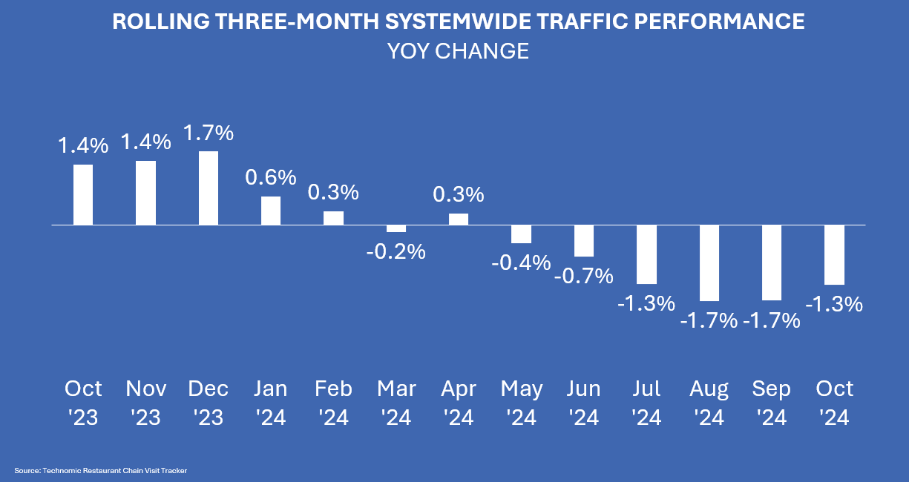
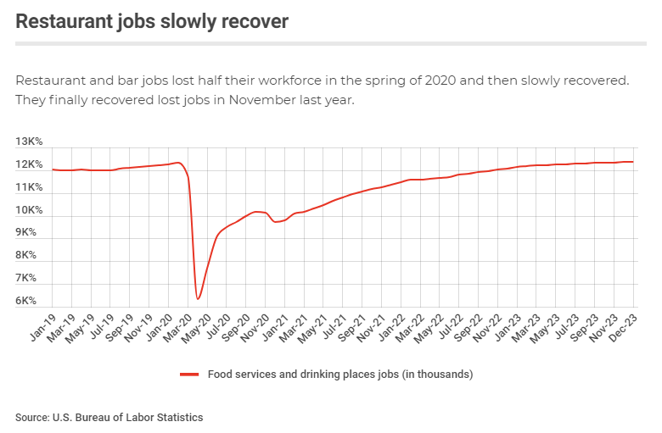
The foodservice industry at its core is about hospitality and the enjoyment of good food.
It is not, however, immune to changing and challenging times.
YoY traffic numbers have been tempered by inflation and “mindful spending” on the part of consumers. And experts at Technomic predict about a 1% loss in foodservice sales by 2035 due to “The Ozempic Effect.”
Labor strains continue given the growth in the workforce lags the demand due to restaurant growth and high turnover rates. Among operators’ top concerns, Technomic reports, 3 of the top 4 are related to labor (cost, retention, hiring qualified employees).

Slide 3

There is good news.
Consumer financial confidence finally rebounds after years of declines, although still well below the pre-pandemic level.
% of Americans 15+ feeling very/somewhat confident that their personal economic situation will improve in 12 months
Great Recession low
NIQ Consumer Life Global 2024 and previous years A1 (US filter)

Slide 4




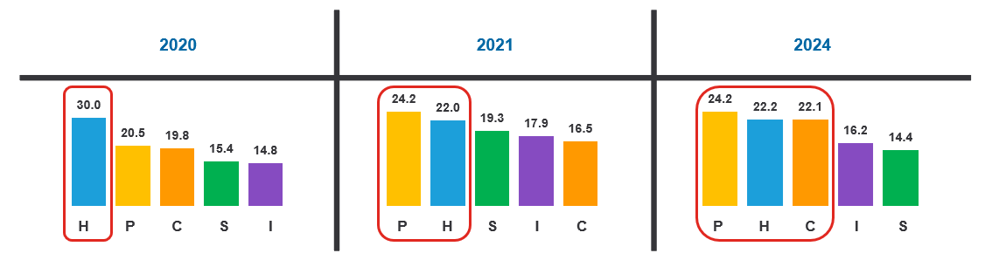
No matter what is going on, when the going gets tough, the tough get going.
The tactics of the foodservice industry might change, but never the spirit.
Cost-In-Use
Value
Hygiene
Cleanliness, Health and Safety
Image
and Quality
Productivity
and Service
Sustainability
Environmentally Friendly
CHIPS represents different areas of focus, and priorities, or the level of focus given to each, tends to shift with changes in the industry.
Challenging times call for WISE choices.
COVID-19 makes hygiene the primary area of focus
Severe staffing shortages and health and safety
are paramount
Continued labor challenges, inflation and hygiene requirements add complexity
GP PRO Proprietary Research: PRO-23-1165705
Base: 2020 Foodservice n= 65, 2021 Foodservice n=51, 2024 Foodservice n=142

Slide 5
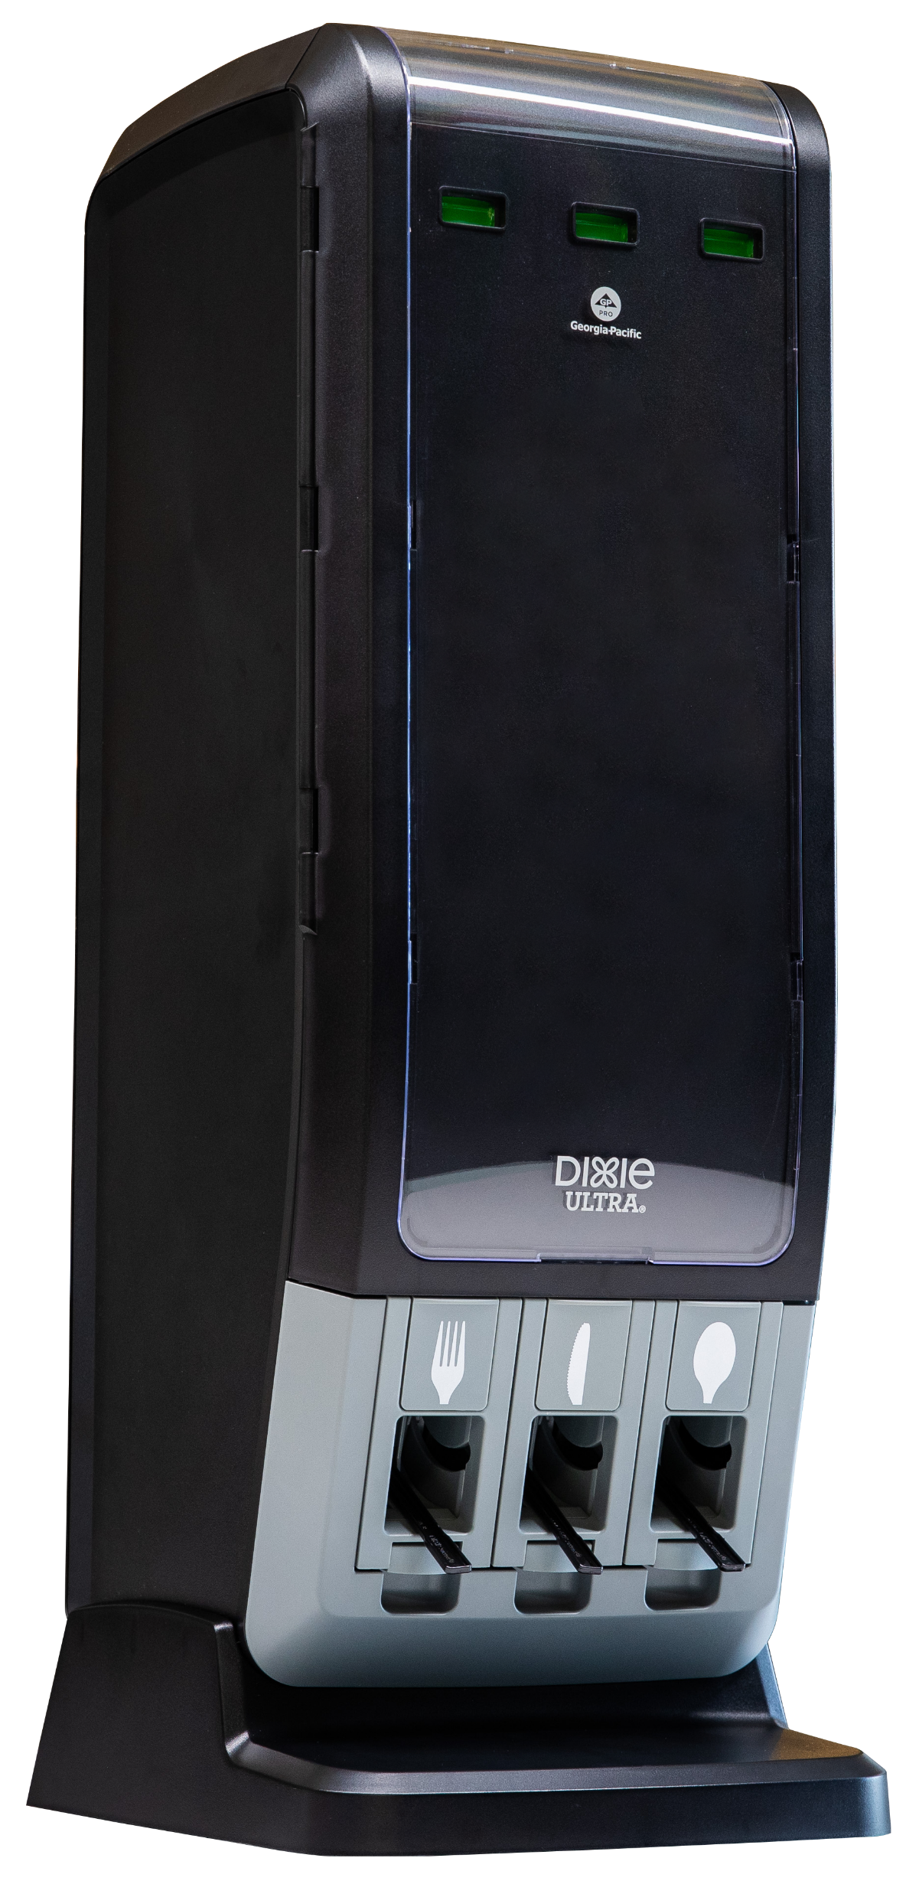
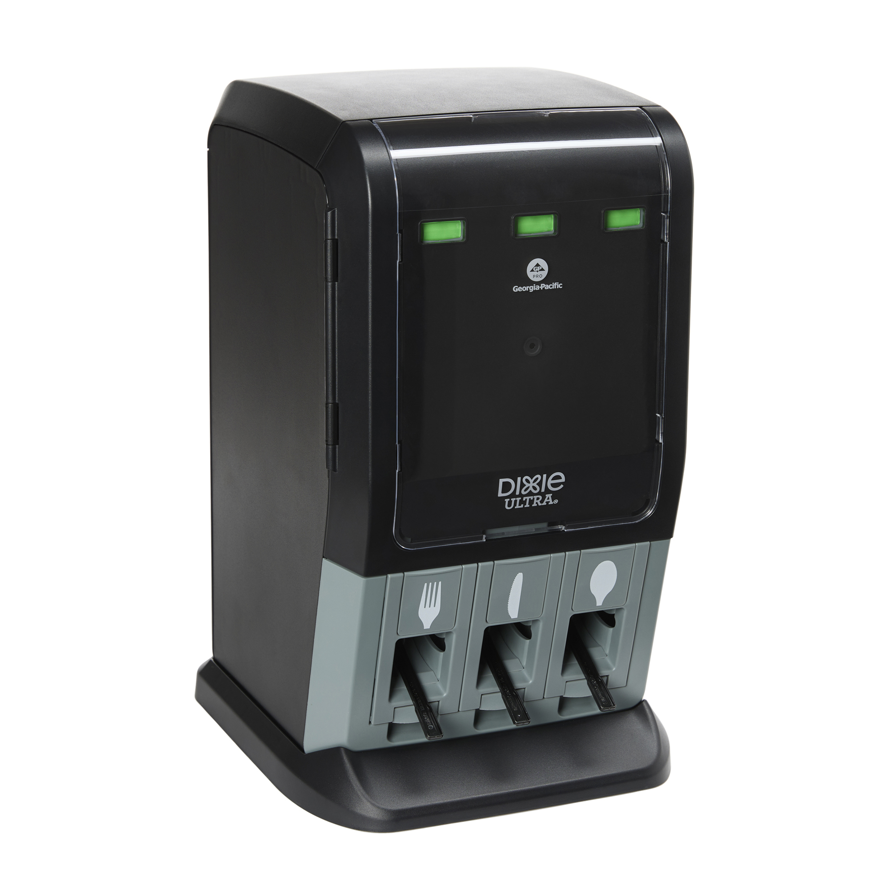
Dixie ultra® smartstock®
Tri-tower cutlery dispenser
COST-WISE
Less (waste) is more (profit).
One-at-a-time dispensing encourages taking only what you need.
SIZE-WISE | IMAGE-WISE
It’s all about the fit.
Sized and styled to fit your environment.
The
WISE Choice
PRODUCTIVITY-WISE
Set it and forget it… almost.
High-capacity means less frequent refills.
No more guessing games.
Know status at a glance – and from across the room.
HYGIENE-WISE
Bringing confidence to cleanliness.
As our teachers taught us, only touch what is yours.
SUSTAINABILITY-WISE
Stewardship matters.
Waste reduction plus a choice of traditional materials or commercially
compostable materials.

Slide 6
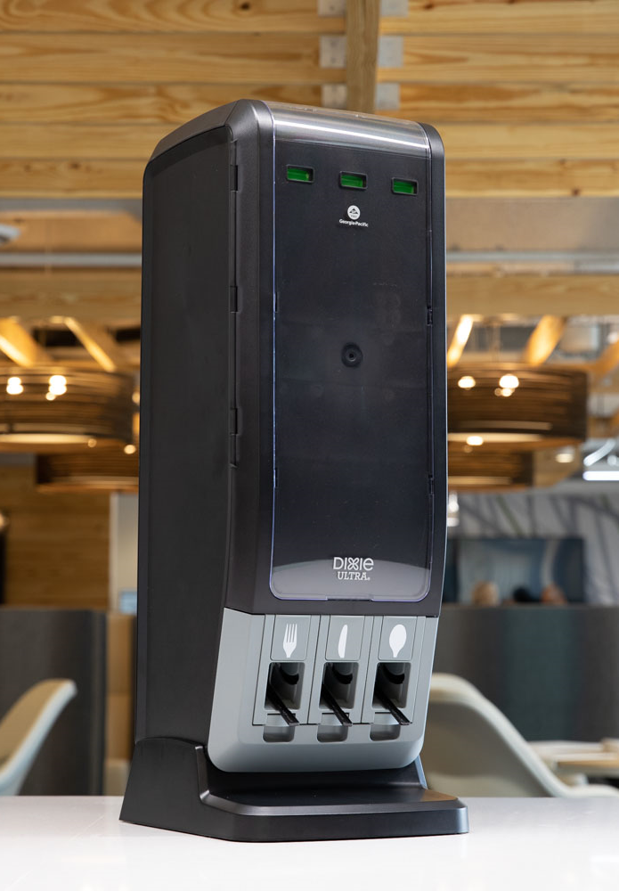
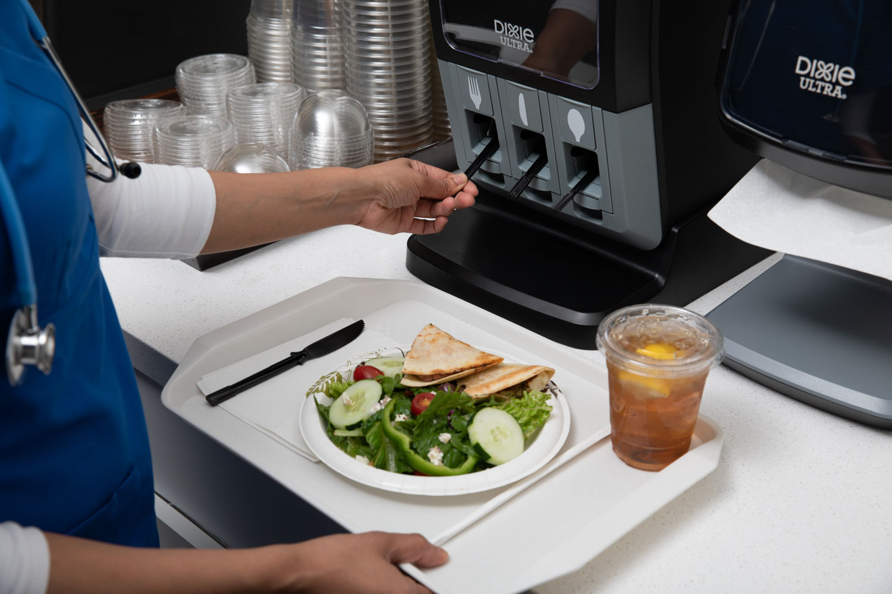
COST-WISE
Less (waste) is more (profit).
One-at-a-time dispensing encourages taking only what you need.
Remember the kids on Halloween who took more from the candy bowl than they should? Some people never change.
You want to provide what people need to enjoy their meal. Open bins, however, are vulnerable to waste and pilferage.
One-at-a-time dispensing encourages mindfulness.
Clear labeling also helps people identify and grab just the type of utensil they need – a better experience compared to the blind reach into an open bin.
Reduces
Cutlery
Usage by
31%*
*GP PRO Proprietary Research: CUT-19-2024 Compared to open cutlery bins on average

Slide 7
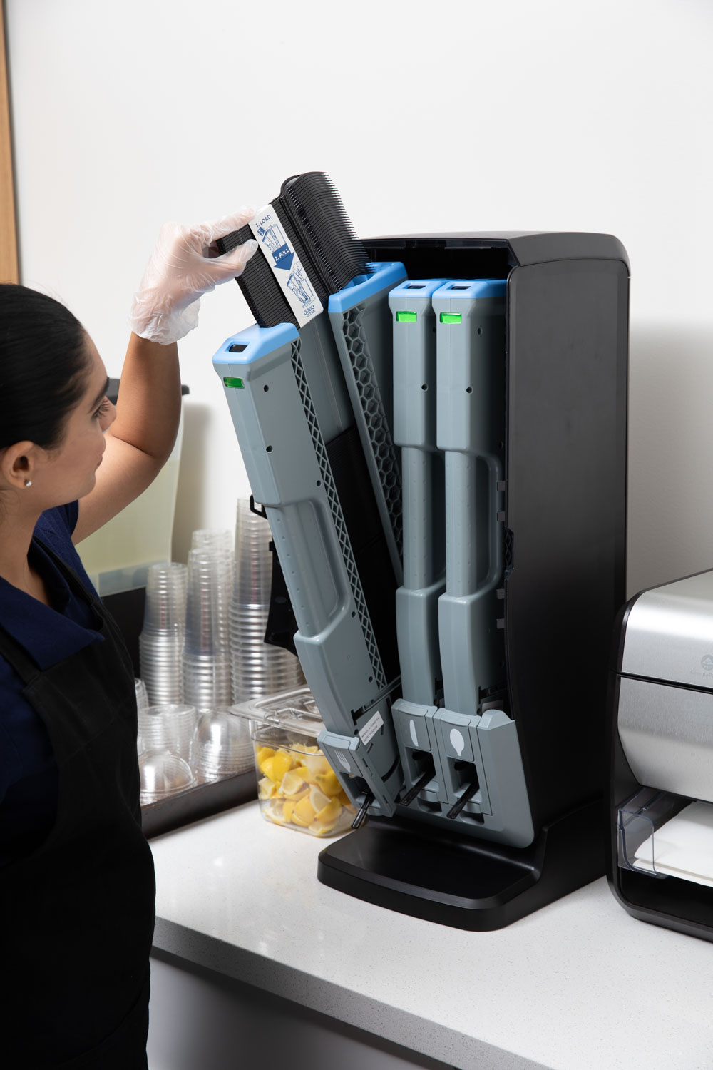
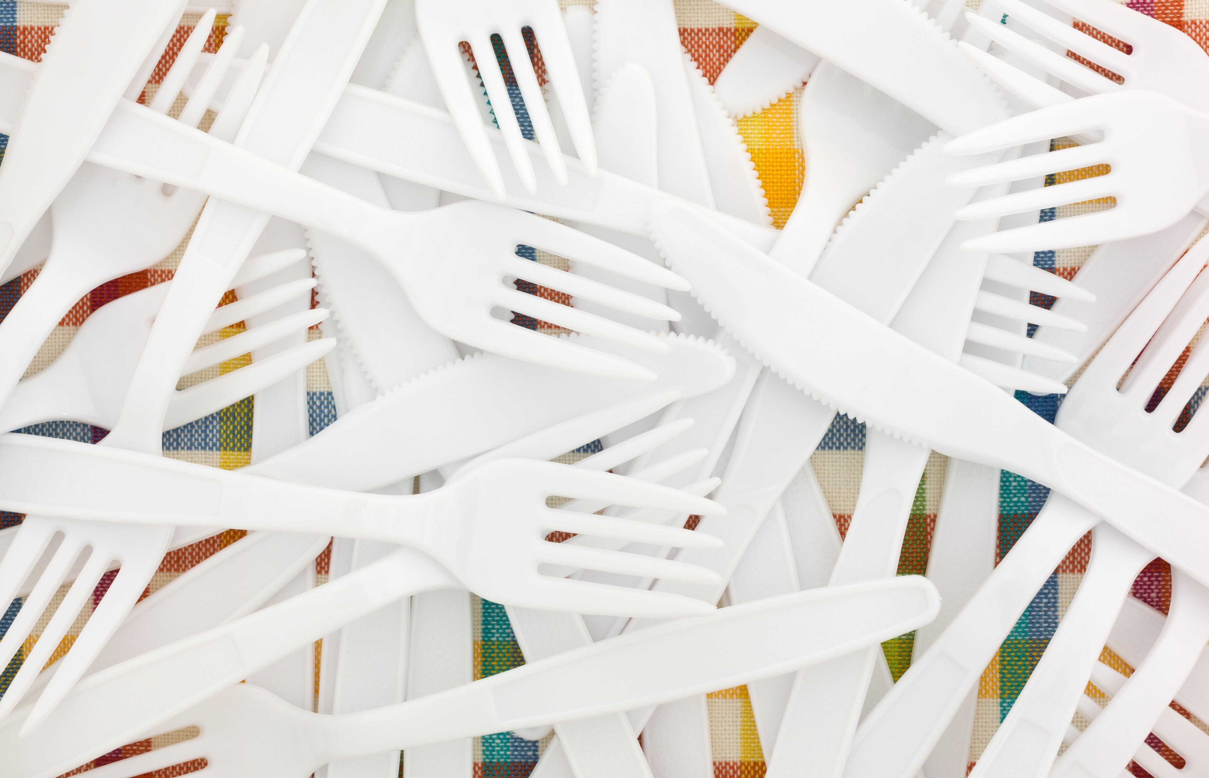
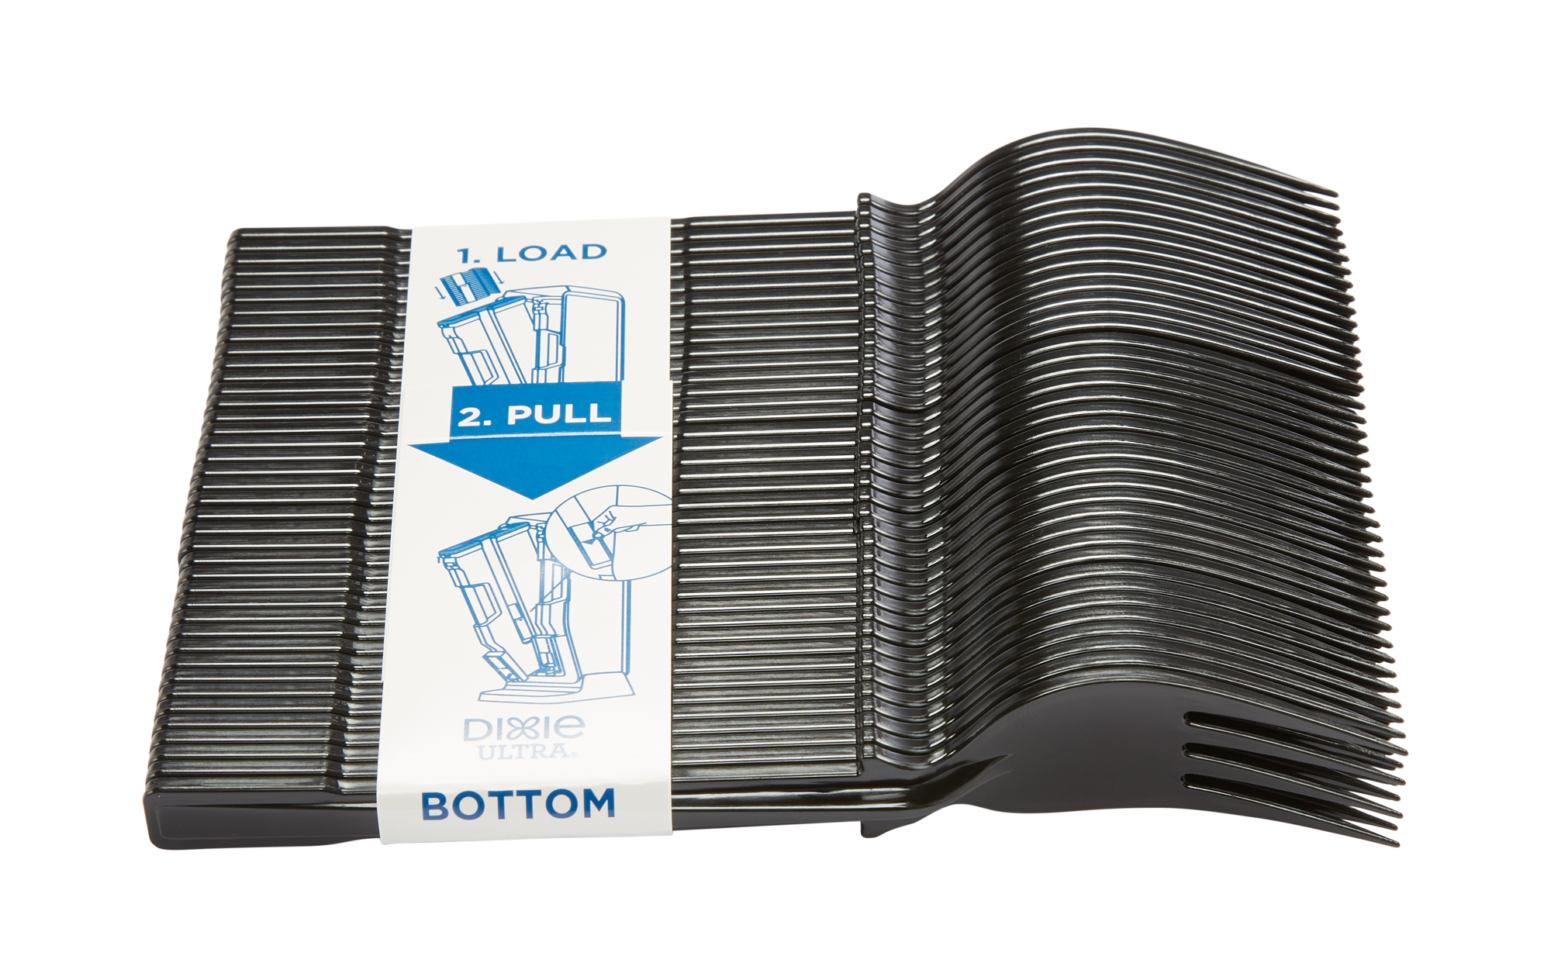
COST-WISE
Foodservice operations require one to move quickly… like race car fast.
Remember the childhood game (or prank!) of “52 Pick-Up?” One wrong move refilling bins with handfuls of bulk cutlery and that is the game you are playing… and your investment quickly becomes waste.
Not the case with the Dixie Ultra® SmartStock® Tri-Tower Cutlery Dispenser. Utensils are pre-counted and neatly packed for accurate inventory counts and quick error-free loading.

Slide 8
COST-WISE
Don’t stock (or buy) what you and your guests don’t need.
Ever run into a variety pack of products where you wanted or even liked each type? (Nope.)
Pre-packaged cutlery sets leave you with little flexibility and can feel wasteful to guests when they receive more than they need.
With Dixie Ultra® SmartStock® Tri-Tower, you pick the mix.
Menu items don’t require a knife? No worries.
Soup and sandwich combos only need a spoon? Easy.
Need more forks than knives? You got it.
The three universal chambers let you fill the dispenser to match the need, giving you flexibility should your menu change.
Interchangeable badge indicators help guests identify, and only take, the right utensils – more guessing games avoided.
And yes…
the SPORK is now an option.

Slide 9


SIZE-WISE
It’s all about the fit.
We know not all spaces are created equal, however, it’s a likely bet that space is tight.
The new Mini Tri-Tower is the size-wise choice when space constraints come into play. It brings all the benefits of the original Tri-Tower, just in a smaller shell. Both boast a small footprint and counter-top and wall mount options.
Where capacity is king, the original Tri-Tower stands tall to meet the needs of operators and patrons alike.
Tri-Tower
390 utensils | 12.74”L x 10.53”W x 29.00”H
Mini Tri-Tower
195 utensils | 11.40”L x 10.50”W x 17.50”H

Slide 10
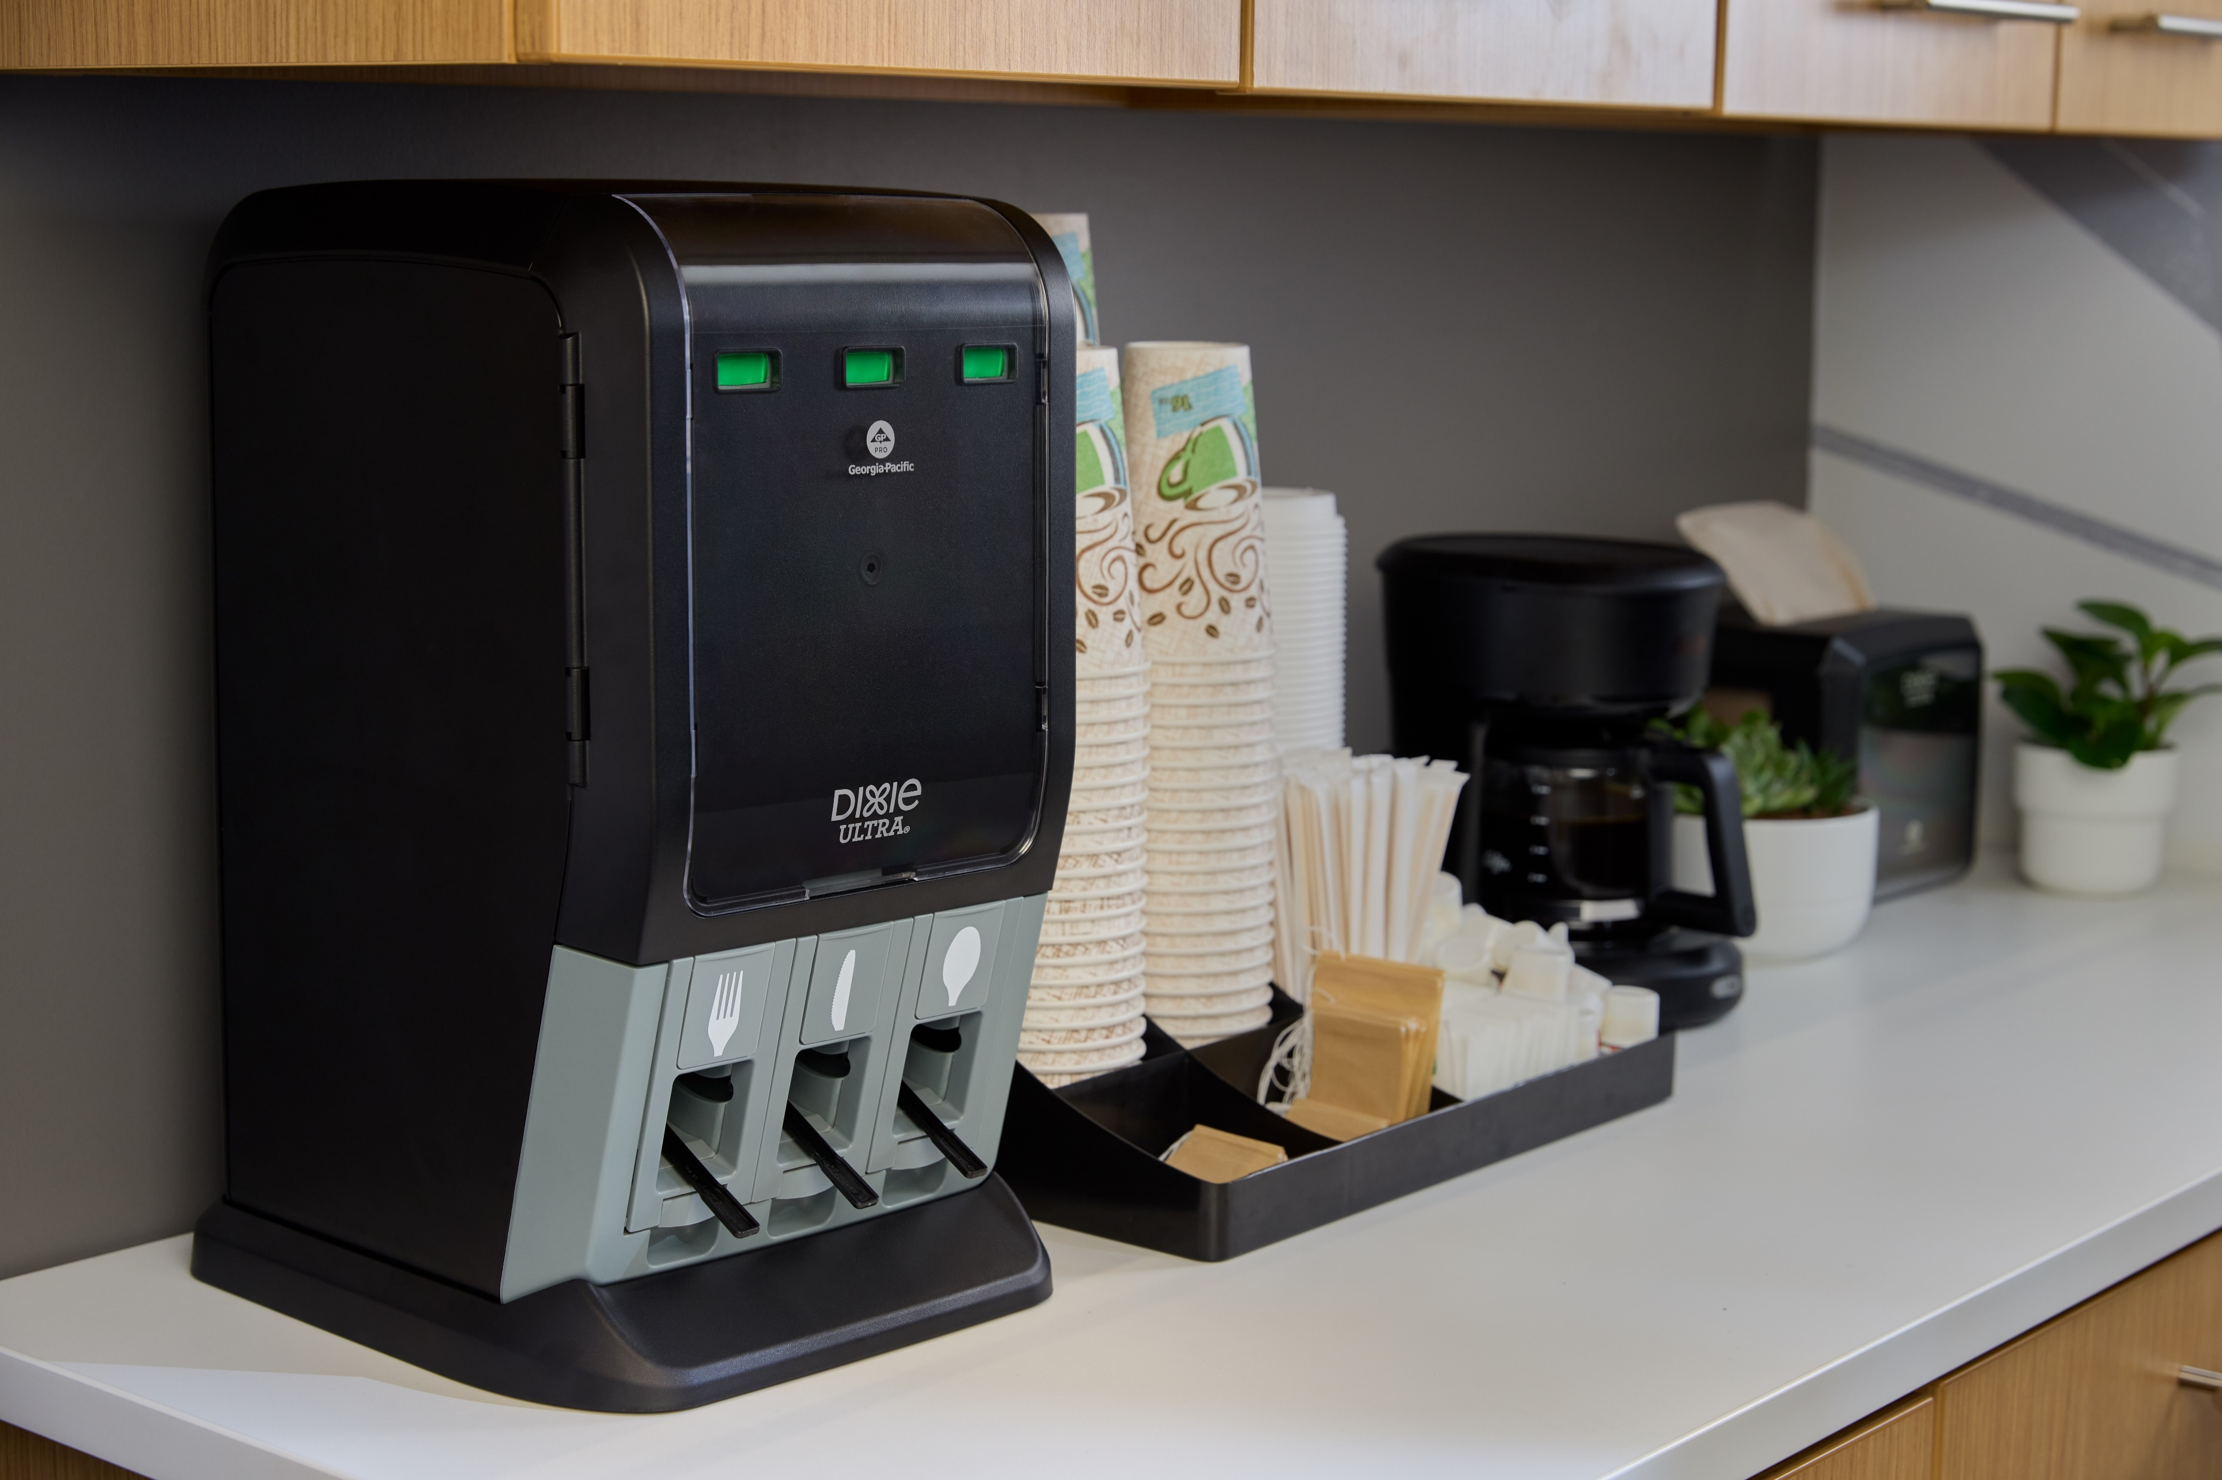
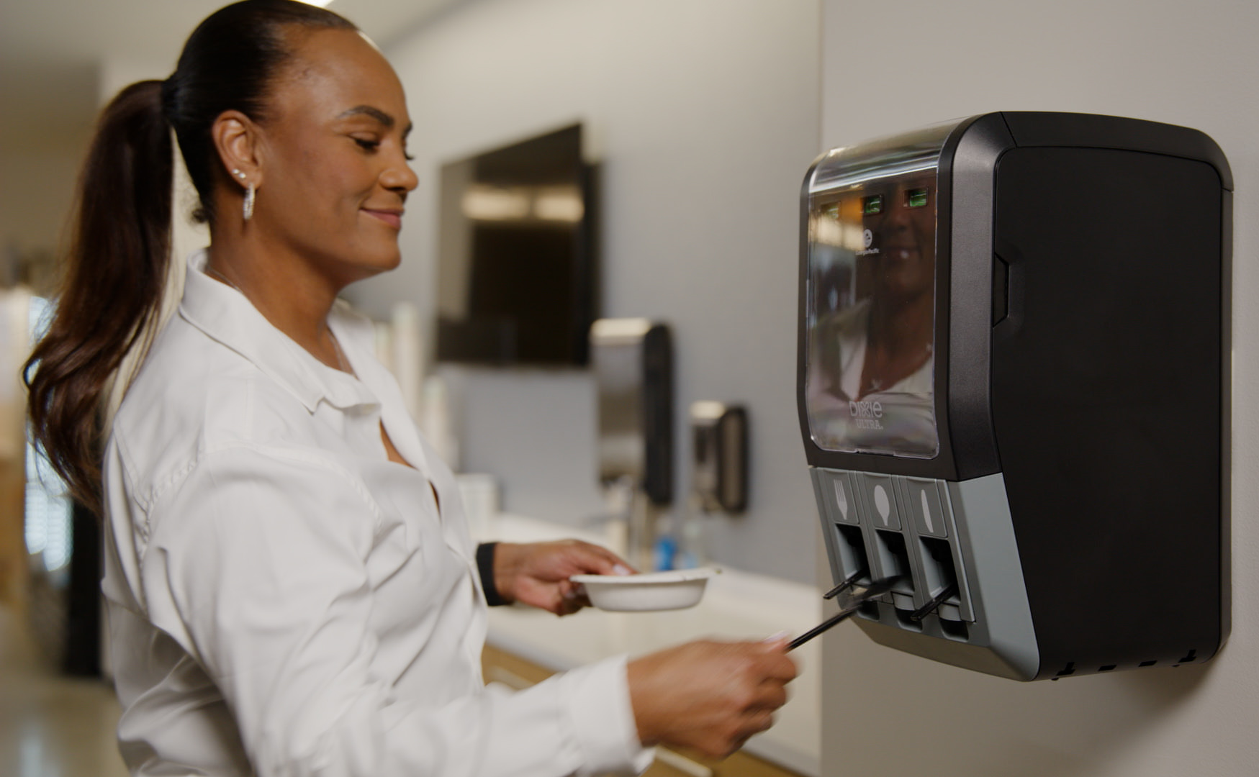
SIZE-WISE
More about the new kid on the block…
Mini Tri-Tower was created in response to operator feedback.
59%
of Decision Makers say they have a dimension restriction that limits their ability to accommodate a cutlery dispenser in their operation / facility.
PROBLEM
88%
of Decision Makers agree they would value the option of a smaller sized cutlery dispenser for their operation / facility.
OPPORTUNITY
99%
of Decision Makers find the Mini Tri-Tower cutlery dispenser appealing for their operation / facility.
SOLUTION
GP PRO Proprietary Research: CUT-P-24-1152
Tri-Tower
390 utensils | 12.74”L x 10.53”W x 29.00”H
Mini Tri-Tower
195 utensils | 11.40”L x 10.50”W x 17.50”H

Slide 11

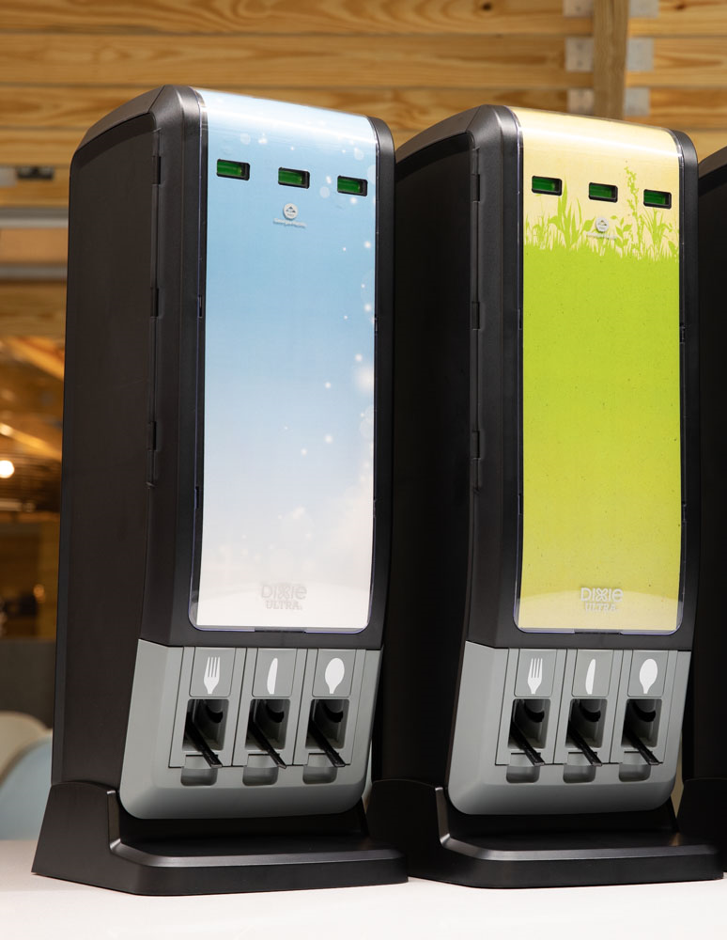
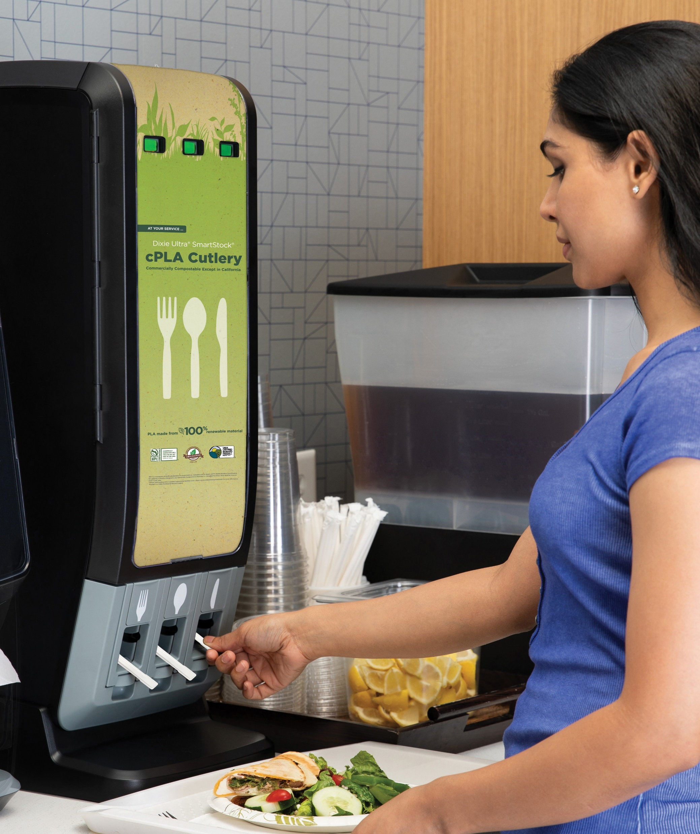
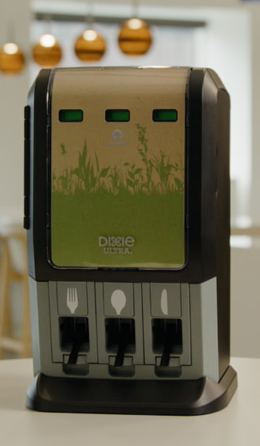
IMAGE-WISE
Fitting in is about more than physical space.
It’s also about matching the vibe or calling out what matters.
You work hard to create a certain environment, the look and feel of your establishment or brand. Food matters, and so does atmosphere.
Customizable inserts are available for the Dixie Ultra® SmartStock® Tri-Tower to add color, reinforce branding or communicate important messaging.
Messaging in unexpected ways and places can disrupt autopilot behavior, and it can surprise and delight guests, bringing another memorable moment to the visit.
It can also affirm your sustainability commitments.

Slide 12
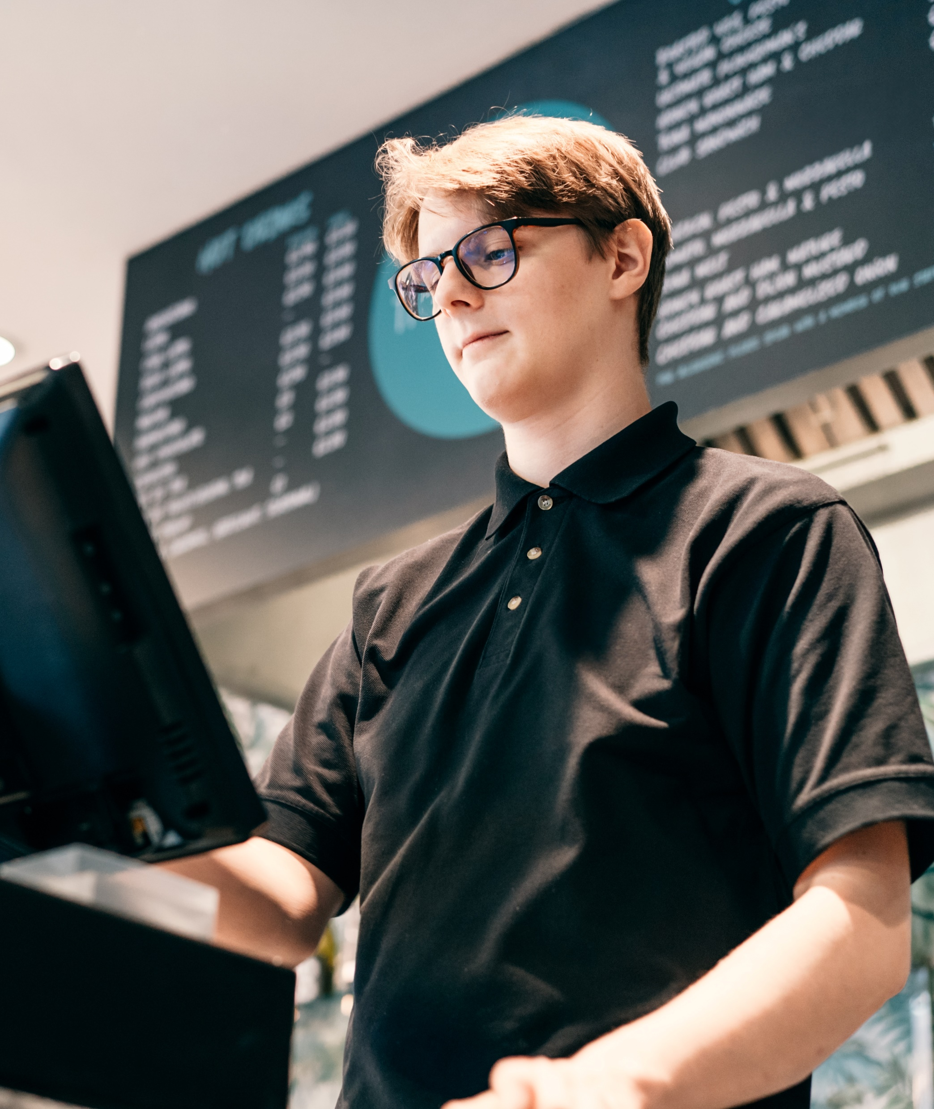
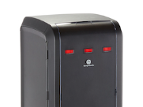
PRODUCTIVITY-WISE
Set it and forget it… almost.
High-capacity means less frequent refills.
Instead of refilling bins multiple times a day, imagine refilling the 390-utensil capacity Dixie Ultra® SmartStock® Tri-Tower 1-2x per week*…
That’s a significant savings of time and effort that can be applied elsewhere, while patrons still have what they need.
* 1 to 2x weekly refills based on 22 total cases of cutlery used annually
No more guessing games.
Know status at a glance – and from across the room.
No more pulling staff away from busy stations to check on supply levels. Red, yellow, green indicators take the guesswork out of when to refill and with how many pieces.

Slide 13

PRODUCTIVITY-WISE
Why wonder when you can know?
Universally recognized “red, yellow, green” status bars for each chamber let staff know, at-a-glance, and from a distance, when the dispenser needs to be refilled and with how many utensils.
Nearly out – Add 3 refill packs of cutlery
(1 refill pack for Mini Tri-Tower)
Watch out – Add 2 refill packs of cutlery
(Not applicable for Mini Tri-Tower)
Compact, banded utensil refill packs mean…
Accurate inventory counts
Easier, hygienic handling
Fast, efficient restocking
Full – Good to go!
Pre-counted refills can help cut loading time by 50%¹
1. Independent research commissioned by Georgia-Pacific

Slide 14



HYGIENE-WISE
Bringing confidence to cleanliness.
As our teachers taught us, only touch what is yours.
Think most people carefully reach in with clean hands, only touching the utensils they take? Wrong.
An open bin invites cross-contamination.
Not a good look.
And it puts your patrons and your business at risk.
One foodborne illness can wreck more than your day with implications for your reputation and your financials.
Still, you require hygiene AND operational efficiency.
No need to compromise.
95%
of Decision Makers agree Tri-Tower efficiencies such as pre-counted cutlery refills could help reduce staff restocking time.
93%
of Decision Makers agree Tri-Tower features such as refill indicators could help employees stay efficient.
GP PRO Proprietary Research: CUT-P-24-1152

Slide 15
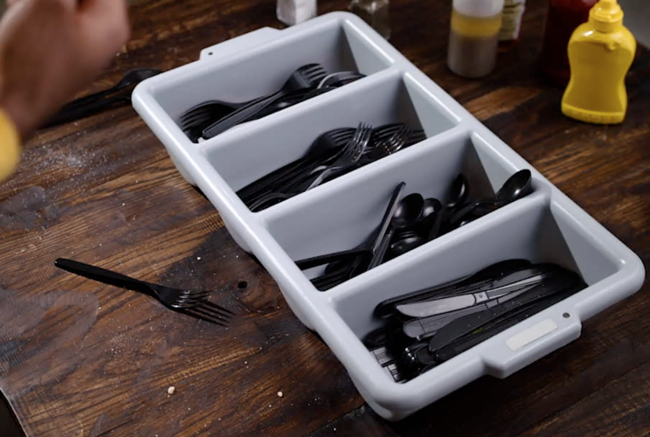
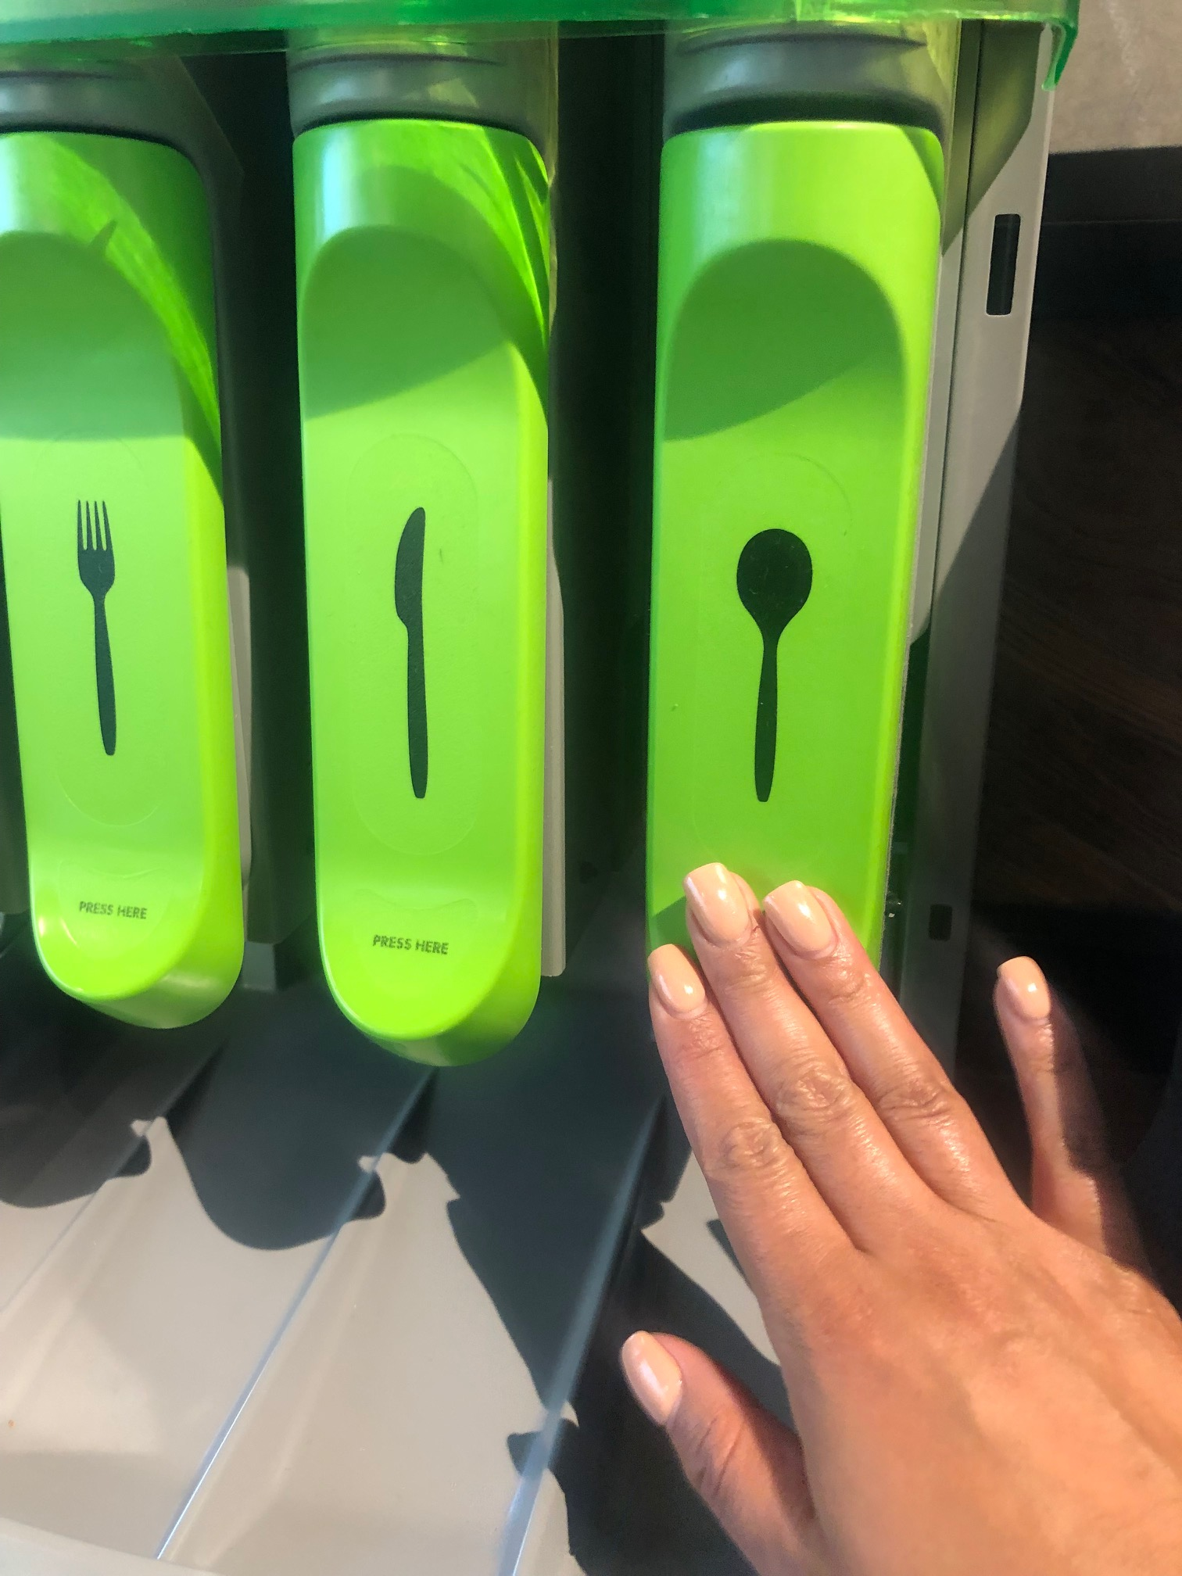
HYGIENE-WISE
REDUCING TOUCHPOINTS INCREASES HYGIENE
of patrons prefer the SmartStock® Tri-Tower dispenser over bulk bins of wrapped and unwrapped cutlery¹
90%
Fully enclosed dispenser ensures product safety and sanitation
Touchless automatic dispensing helps improve hygiene and cross-contamination
Opportunity for touchless loading reduces employee touchpoints and increases hygiene
No levers, trays or buttons (or OPEN BINS!) mean patrons only touch the utensils they take
0
9
1
out of
consumers
VS.
believe it is important that no one else touches cutlery they eat with²
of patrons say a restaurant using Dixie Ultra® SmartStock® Tri-Tower Cutlery shows they’re doing their part to reduce the spread of germs³
86%
Choose the Dixie Ultra® SmartStock® Tri-Tower to put patrons at ease – not at risk.
GP PRO Proprietary Research: CUT-19-46
GP PRO Proprietary Research: CUT-18-1899
GP PRO Proprietary Research: FSS-20-4496

Slide 16
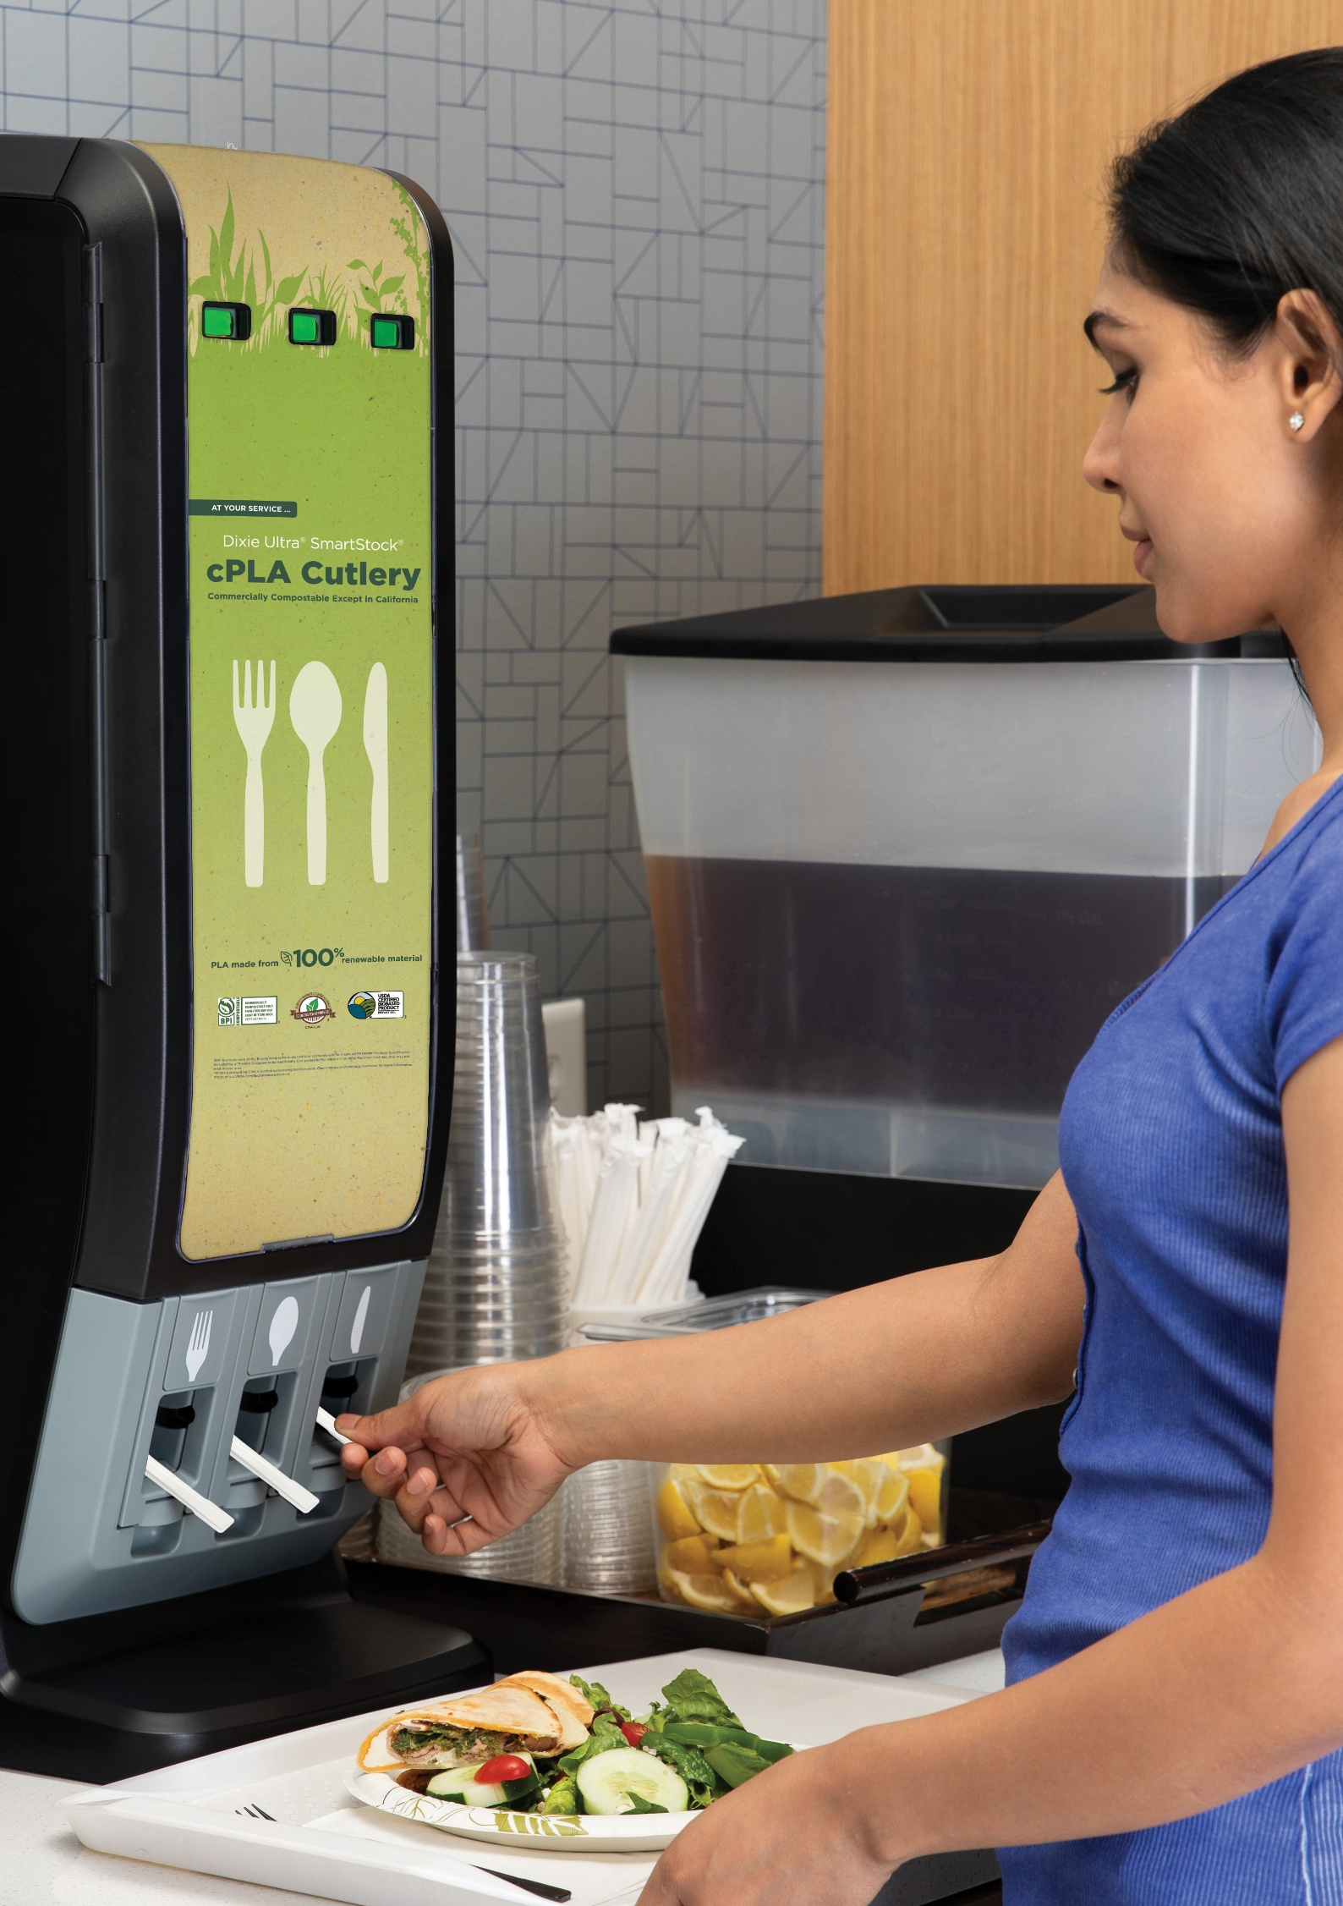
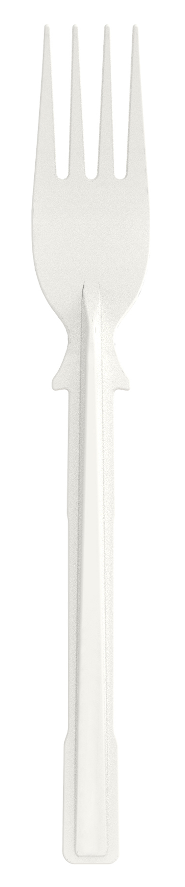



SUSTAINABILITY-WISE
Sustainability without compromise…
that is the Dixie® way.
There is no need to sacrifice performance for sustainability.
Dixie Ultra® SmartStock® cPLA Cutlery is crafted of PLA made from 100% renewable materials.¹
It is certified commercially compostable except in California* by BPI and meets CMA acceptance criteria.
And here’s a big one…
Its strength aligns with SmartStock® polystyrene cutlery, with a heat tolerance up to 200°F, amongst the highest in the industry.²
3
4
1. Renewable materials are plant-based materials that may be grown repeatedly
2. Heat tolerance testing conducted within a controlled environment using standard methodologies
3 BPI® is a trademark of the Biodegradable Products Institute. Complies with or meets ASTM D6400 Standard Specification
for Labeling of Plastics Designed to be Aerobically Composted in Municipal or Industrial Facilities.
4 Where participating CMA Industrial composting facilities exist. Check www.composterapproved.com for more information.
*Commercially compostable only. Facility might not be available in your area.
CMA-I, W

Slide 17

SUSTAINABILITY-WISE
Being a good steward of the planet can also mean reducing waste.
Like reducing cutlery usage by 31%.
Reduces
Cutlery
Usage by
31%*
That reduction in usage translates to cost-savings as well as to 31% fewer disposable utensils hitting the waste stream compared to usage from open bins.
And that’s a beautiful thing, made possible by a wise choice.
*GP PRO Proprietary Research: CUT-19-2024 Compared to open cutlery bins on average

Slide 18

THE WISE CHOICE
Which will you choose?
Make the WISE choice.
SmartStock® Cutlery Tri-Tower Dispenser?
Open Bins with Bulk Cutlery and the Blind Reach-In?
Reduced waste
Elevated image
Hygienic, one-at-a-time dispensing
You pick the mix
Know stock levels at-a-glance
Fast to refill (uses same refills!)
Easy ID badging
Size, look and placement options
Traditional or compostable materials
Spork!
93% of Decision Makers agree the efficiency of Tri-Tower dispensing could motivate them to move away from bulk cutlery
X Potential for waste
X Messy, not contained
X Poor image
X Hygiene risk
X Needs to be monitored
X A guessing game to stock
X A guessing game to grab
The
WISE Choice
GP PRO Proprietary Research: CUT-P-24-1152

Slide 19
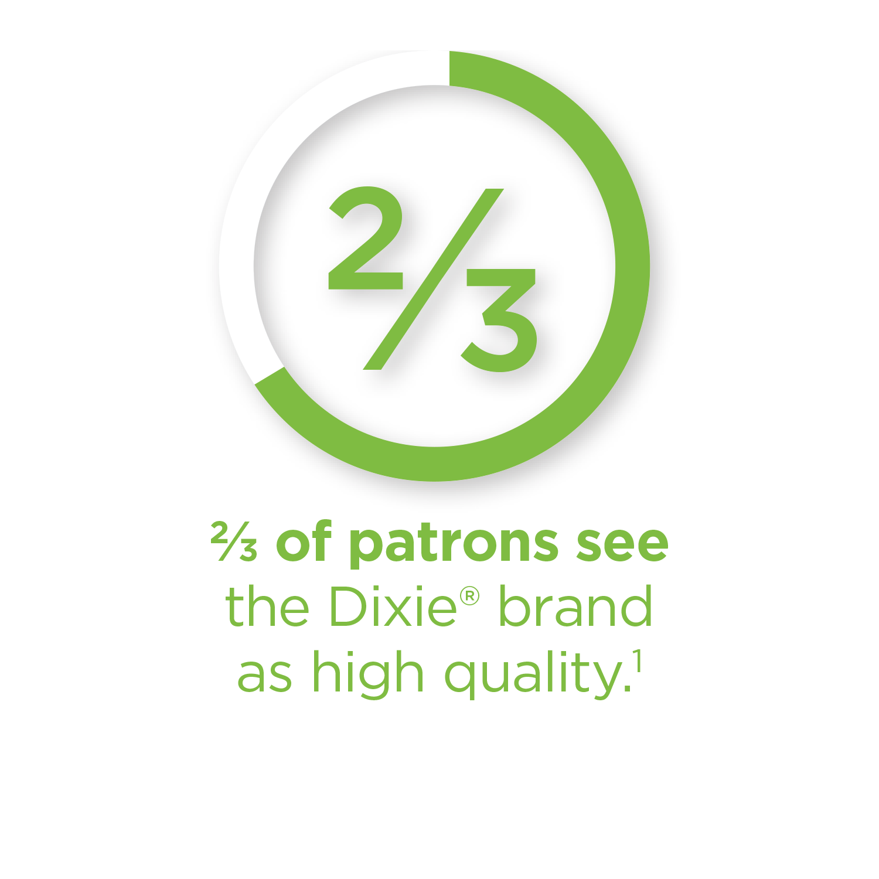

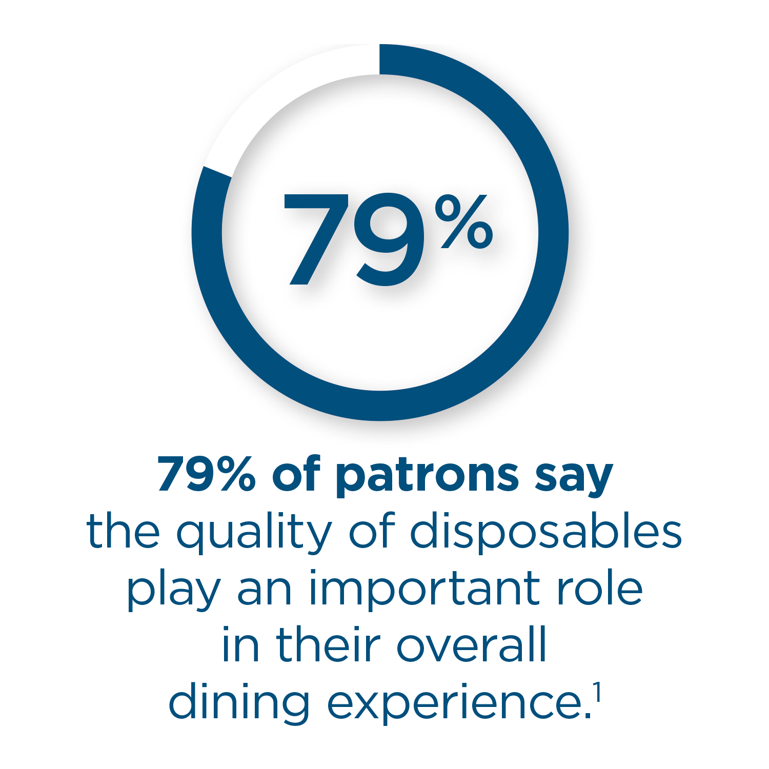
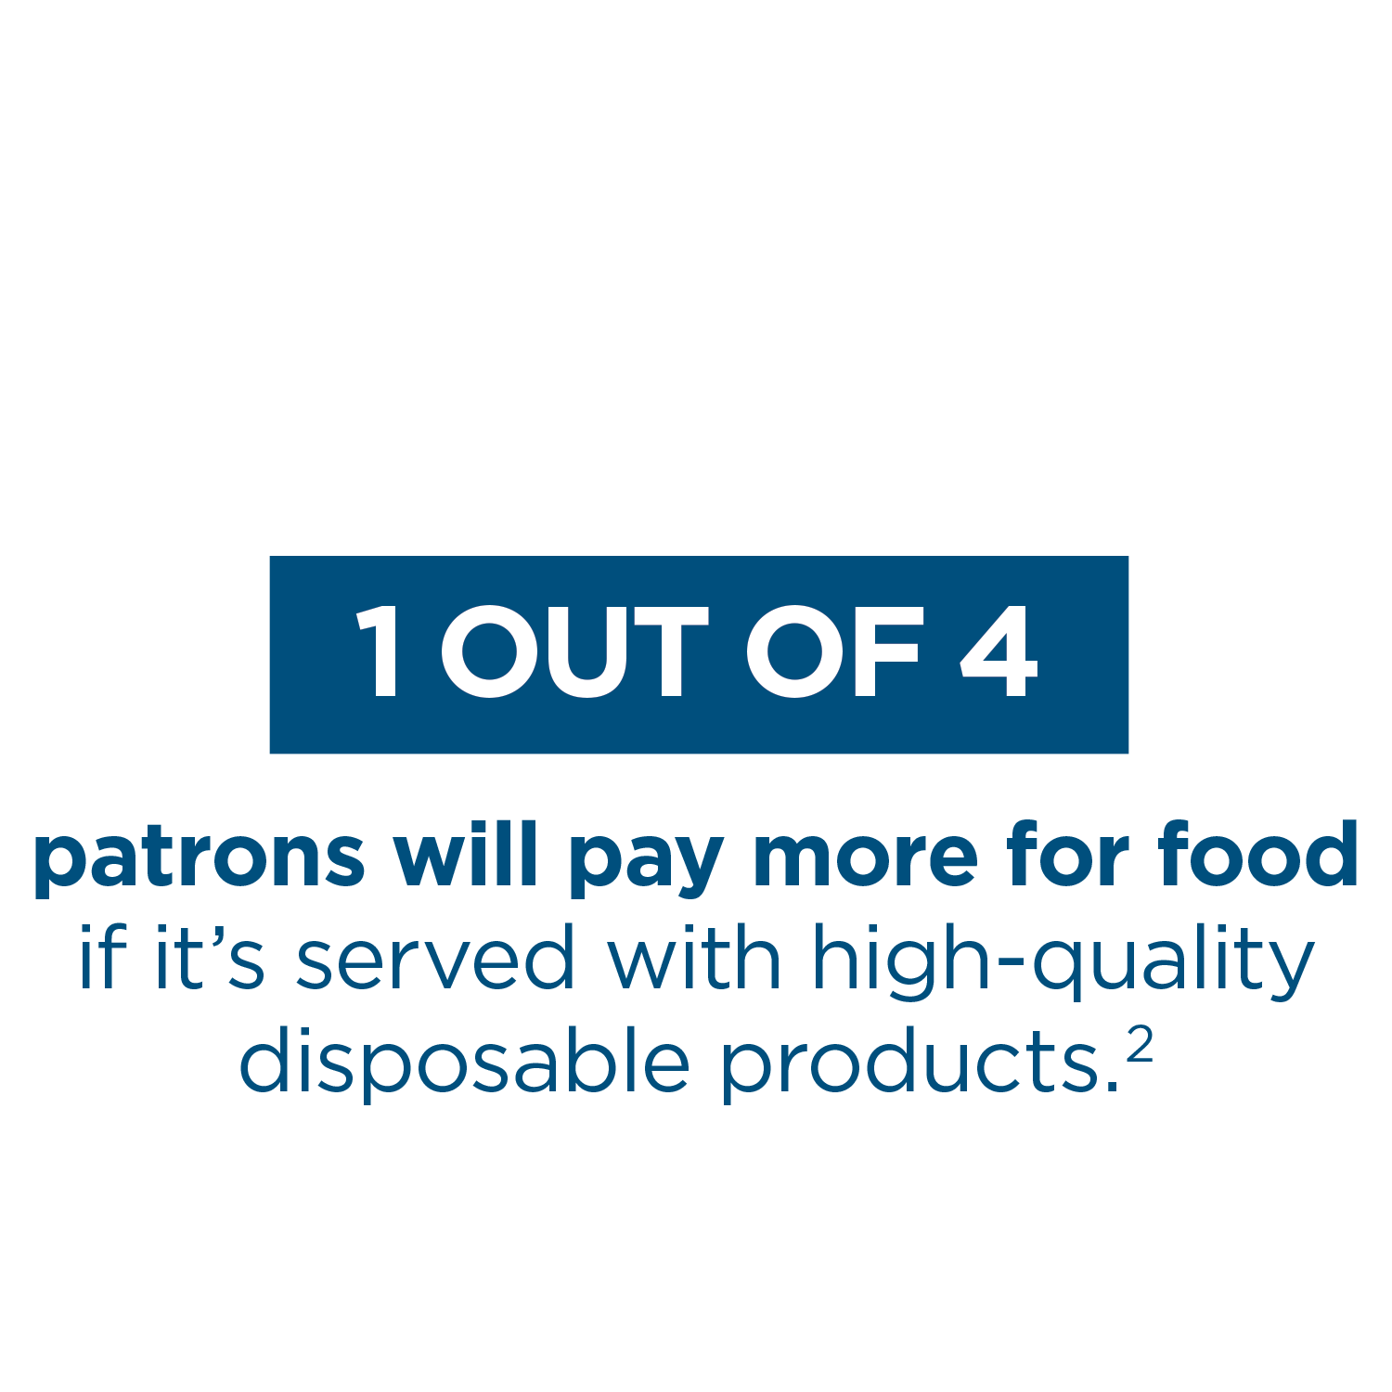
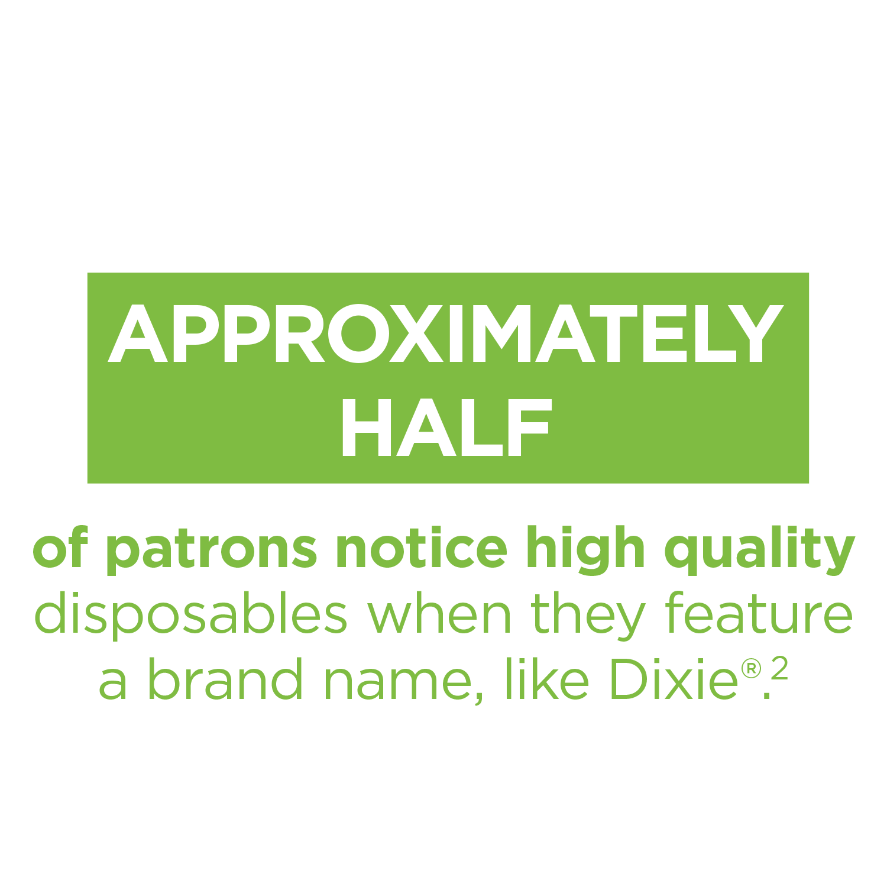
THE DIXIE® BRAND ADVANTAGE
The
WISE Choice
With a legacy spanning over a century, Dixie® brand products are recognized and trusted by both patrons and operators alike. Time and again, successful foodservice operations build their businesses using quality Dixie® and Dixie Ultra® disposables and dispensing innovations that consistently deliver on efficiency, sustainability, hygiene and value.
1 Source: 2017 Omnibus Survey
2 Of respondents familiar with the Dixie® brand; 2017 Omnibus Survey

Slide 20

PURPOSEFUL DESIGN | Driven by Market Knowledge
The Dixie Ultra® SmartStock® TriTower Cutlery Dispenser has been developed with key markets in mind, designed to deliver meaningful benefits to a variety of foodservice operations.
HEALTHCARE
FOODSERVICE
HIGH
TRAFFIC
RETAIL
(GROCERANTS)
OFFICE
BUILDINGS
INDUSTRIAL
LODGING
EDUCATION

Slide 21
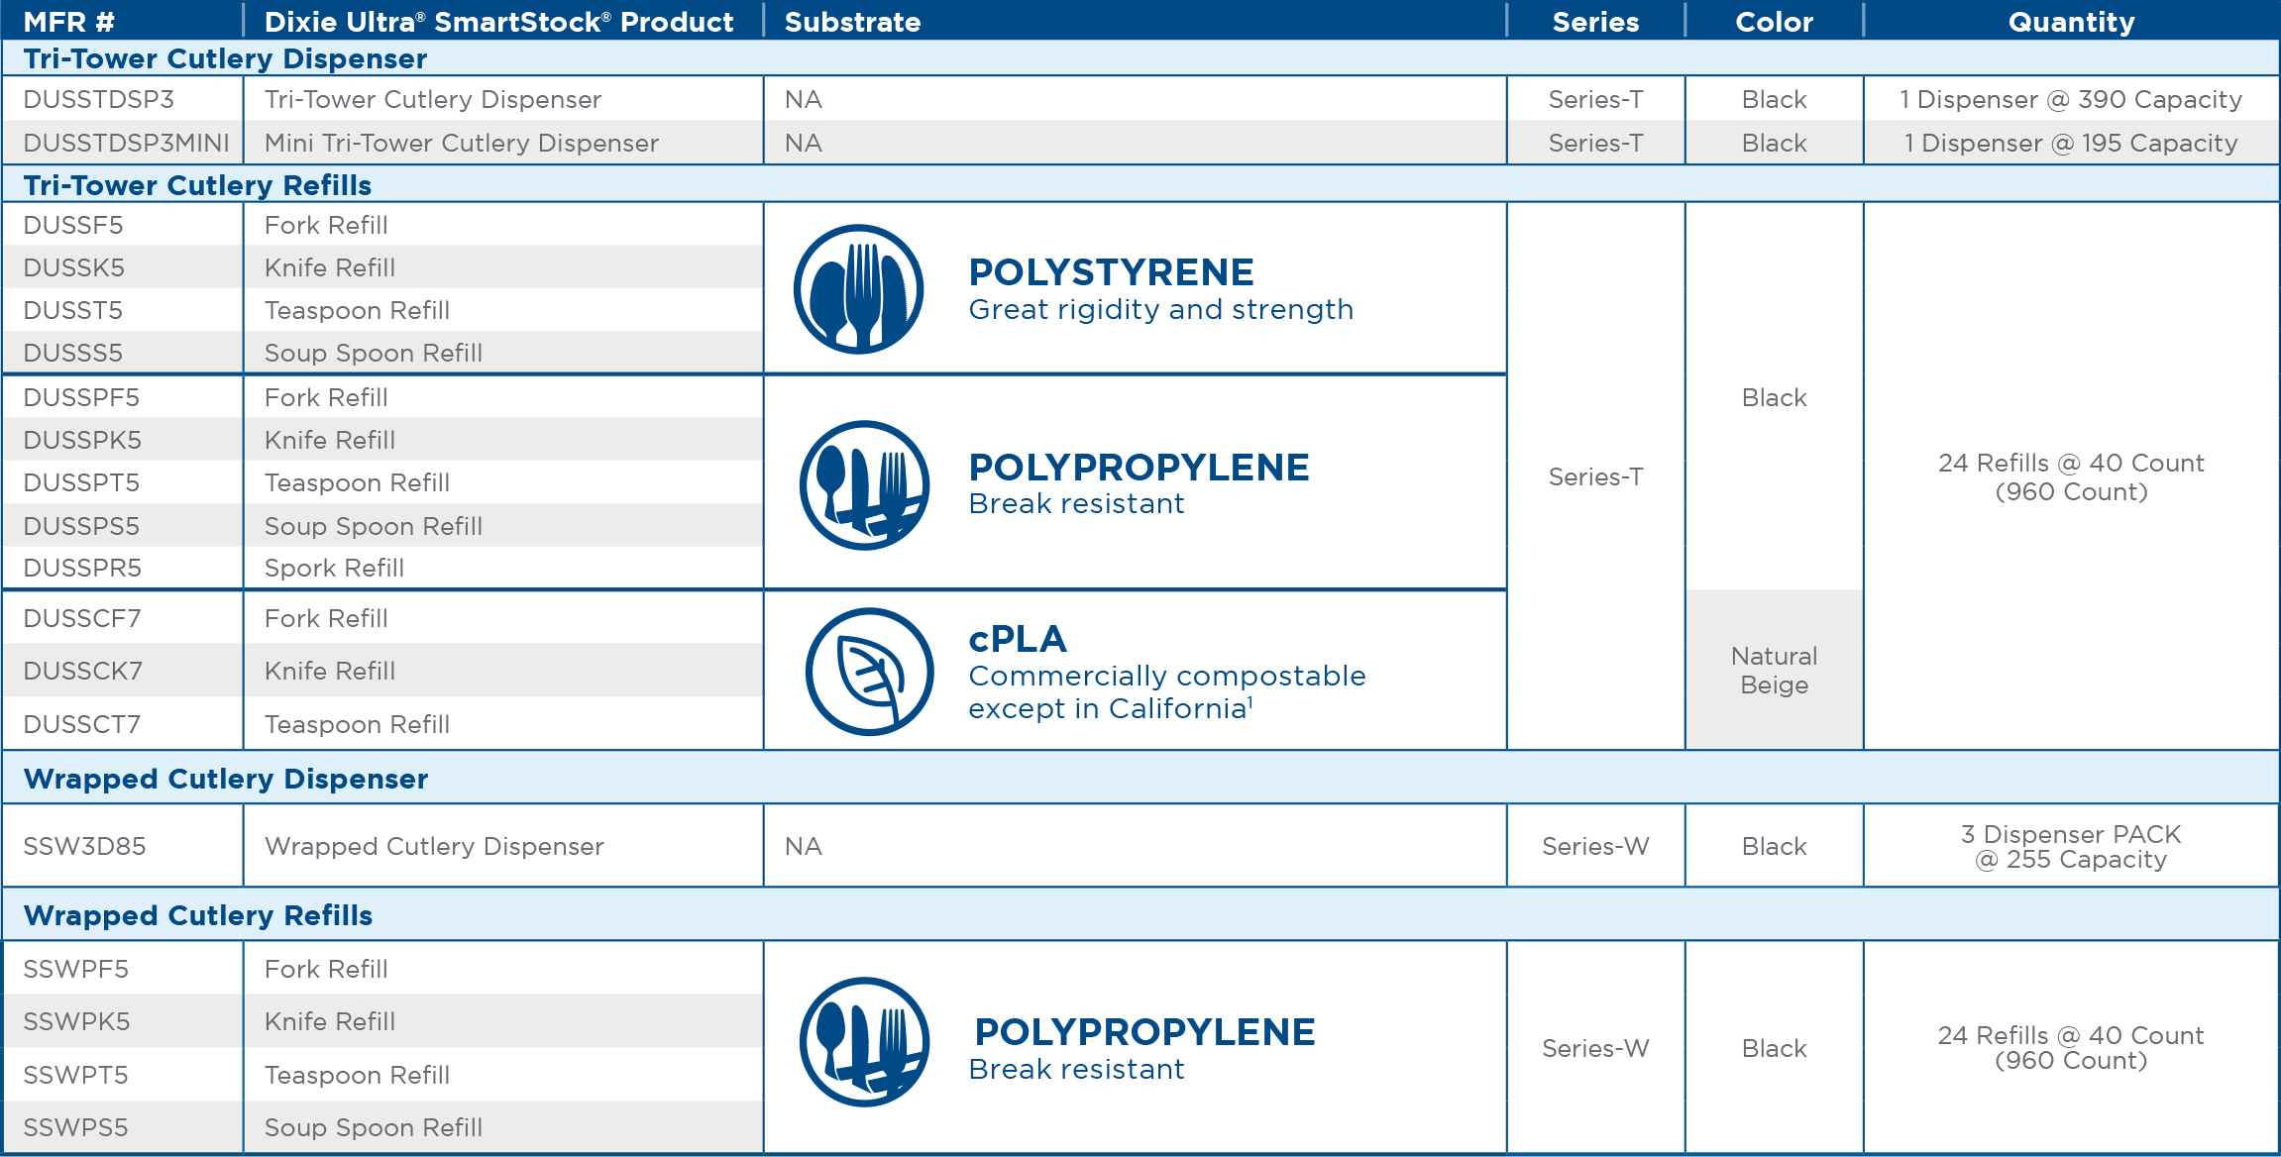
READY TO MAKE THE WISE CHOICE?
Contact your GP PRO representative to learn more – 1.866.HELLO.GP (435.5647)
*Commercially compostable except in California in commercial composting facilities. Such facilities might not exist in your area.

